Slide 1
Other NoSQL Solutions

Slide 2
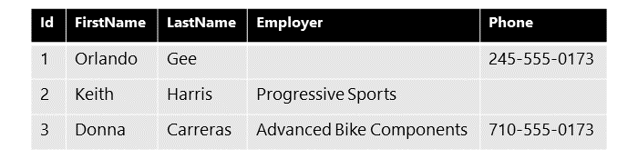
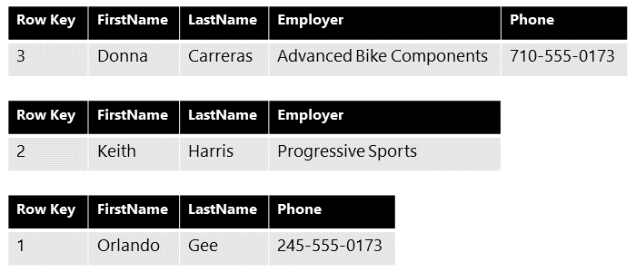
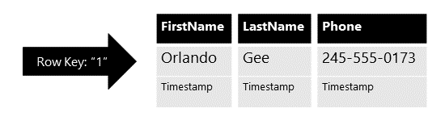
Cassandra

Slide 3
Lucene & Solr
Lucene
Java-based indexing engine
index large amounts of data quickly using the least amount of RAM possible
JSON, CSV and XML
Rich documents like pdf or docx
Solr
search engine that runs “on-top” of Lucene
location-based search on Geospatial data
query suggestions and spell-checking for auto-complete forms
RESR API

Slide 4
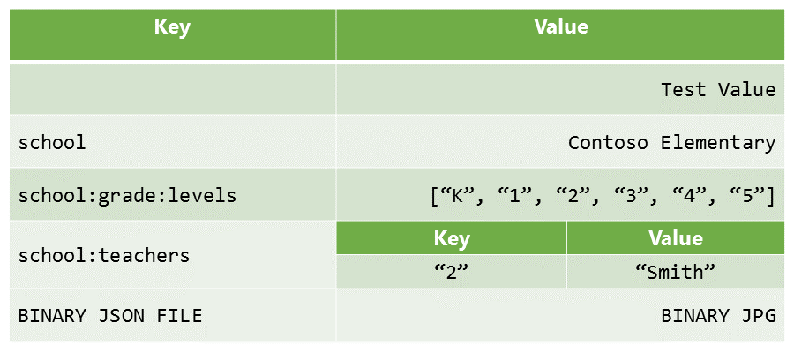
Redis
in-memory key-value based data store
lists, hashes, geospatial
cache

Slide 5
Quiz
What is the difference between column-oriented and relational DBs?
What is an advantage in using SolrAPI?
What is the main feature in Redis DB?

Slide 6
Vocabulary
Word | Definition | Examples
wonky | weak, unsatisfactory, or not firm; not straight or level. | One of the legs on this chair is a bit wonky.
scratch/scrap the surface | to deal with only a very small part of a subject or a problem | There's far more to be said - I've only had time to scratch the surface in this talk.
facilitate | to make something possible or easier | The new ramp will facilitate the entry of wheelchairs.

